Slide 1
The Heys School
How to “Maximise” Potential in the Approach to GCSEs

Slide 2
Welcome
Thank you for attending our Maximise evening. The aim of this is to get feedback from teachers about student progress towards examinations, but also to look at how parents and students can be working outside of school hours to maximise progress.
Alongside the talks from staff this evening, each subject leader has created a short guide to their subjects’ upcoming examinations and ways students can revise at home in order to continue their learning. This includes links to revision materials, recommended websites and guides that can be purchased. We have sourced these links to ensure we signpost the correct materials, however, we do not recommend any specific retailer to purchase these guides and workbooks from and receive no commission for this.
We understand that exam season is nerve-wracking for both students and parents, and are often asked how parents can support their children in the best possible ways. Some strategies we recommend are as follows.
Create a revision timetable with your child and help them to stick to this. There is no point that is too early to start revision.
Create an effective learning environment for your child. Ensure they have a quiet, organised space to work in with no distractions, take regular breaks and are well-rested.
Take an interest in your child’s learning and progress. Research shows that emphasising the use of content can increase motivation. Acting as the student and getting your child to explain a topic is proven to be one of the most effective methods of retaining information. Repeating information often helps to remember more, so short quizzes and questions from you will help your child remember more.
Support your child in getting to school on time each day. Being in lessons will be the optimum way to help them make progress.
If you require any support, please feel free to contact staff at The Heys School, who will be more than happy to assist.

Slide 3
Resilience
13 Top Tips to make your revision effective
1. Start revising early - months, not days before the exam.
2. Timed focused revision - 40-minute active sessions then 10/20 minutes off and repeat
3. Continuation - Plan your revision using a timetable, means you can spend more time revising and less time worrying you've forgotten something.
4. Stick to the plan - Don’t make excuses for avoiding revision – and if you do miss a ‘session’ make up for it.
5. Don't spend ages making your notes look pretty - This is just wasting time. For diagrams, include all the details you need to learn, but don't try to produce a work of art.
6. Location (set up a nice, tidy study space) - Good lighting, pens close by, phone out of sight and TV unplugged. Try not to revise on a bed.
7. Vary your revision with different activities - Try a variety of different revision techniques — answering practice questions, writing down notes from memory, and using Revision Guides, Flash Cards, Exam Practice Workbooks etc.
8. Stick the challenging revision notes all around your house - In the exam you think, "Aha, quadratic equations, they were on the fridge..."
9. Practice papers and questions – Get expert help! It’s far easier to answer questions in the exam if you've tried similar ones beforehand. Have a look at your exam board's website for a selection of sample papers.
10. Overview (Set aside time to do fun things) - Don't totally stop having fun. This'll help motivation and relaxation
11. Keep your phone and other distractions away. - Phones are great but encourage procrastination. Heed our warnings and stick it in a drawer while you're revising.
12. Don't just read your notes - You have to WRITE STUFF DOWN.
13. Take your revision wherever you go - Even if you find some books aren't quite portable enough, lots of Revision Guides and Textbooks come with handy online editions.
How to overcome failure
1. Past papers/ Practice exam questions Do – Practice past papers alongside your revision sessions and within your schedule
Don’t – Just use these past papers in isolation as they only cover a small part of the specification
2. Check Check Check - Misconceptions
If you don’t understand a concept or understand how it works – ask your teacher
3. Focus
Don’t give up when you don’t get something – move on and come back another time/day
4. Peers (Friends)
Support each other don’t criticise schedules and times.
Portable location
Box
Pens
Pencils
Rulers
Highlighters
Folders of Subjects
- Revision Guides
- Past Papers

Slide 4
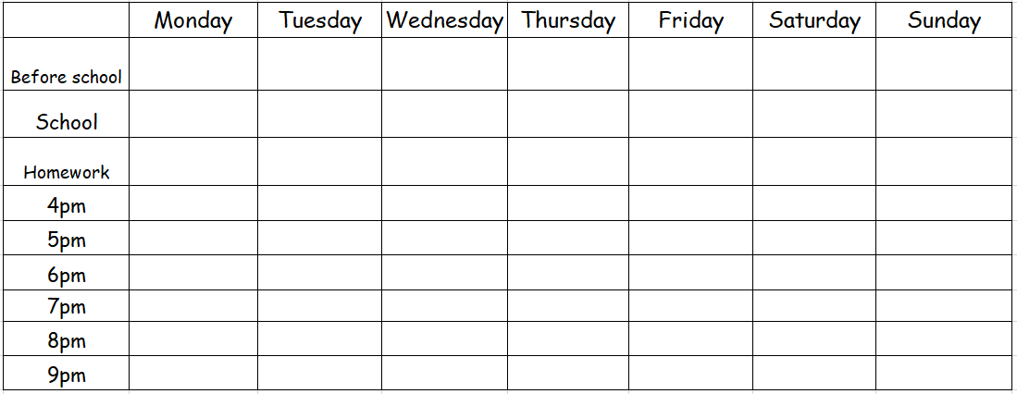

Slide 5
Revision Techniques
Past papers are previous exams that have been released by the exam boards. They have released 2022 with mark schemes and all years previous
Flash Cards: a card containing a small amount of information, held up for pupils to see, as an aid to learning
How to use them:
1 – Write down key information from specific case studies – ask family to test you (Verbally)
2 – Create flash cards – Theme on one side
Recall all information verbally / information missed rewrite this in notes
Repeat
3 – Key quotes / formula / information and read over for short intense revision
4 – Purchase external providers using their questions to guide your learning
8 4 3 1
5 1 8 3
1 5 8 7 4
6 9 8 2 1
5 3 7 6 2 9
10 8 3 9 1 4
1 10 2 8 3 6 2
7 5 8 4 6 1 10
5 10 7 1 2 3 9 6
9 4 8 7 5 10 3 7
9 4 7 3 10 1 6 2 8
6 9 1 3 7 10 4 8 5
Advantages of using Past Papers
1. Familiarity with the structure of a paper and the language they use.
2. Work on your time management
3. Understand the allocation of marks and marking scheme
4. Good way to practice writing
5. Analyse
Examiner’s reports
If you want to take your revision a step further, then it’s also a good idea to read the examiners’ reports for past exams. These are available online. You just have to search for the examiner’s report for the exam board, the subject and the year.

Slide 6
Support
Mr Small Mr Jones Miss Phillips (H2)
KS4 Office at social times
Prom information:
Theme: The Great Gatsby Masquerade Ball.
Start at 6.30pm and end at 10.30pm.
Friday 28th June 2024 at the Stables Country Club Bury.
Feelings/Emotions
What you will experience:
Increased anxiety
Increased stress
This is normal
Control the controllables
Be organised
Follow the practical advice given.
90% attendance means your child misses a total of 19 days of absence over the academic year.
Department for Education research shows that 17 school days of absence results in all of a student’s GCSE grades dropping by one grade.
17 – Actual Weeks left until 13th May
15 – In school Weeks until 13/5
45 – Maximum Options lessons left
Get in front of the experts

Slide 7
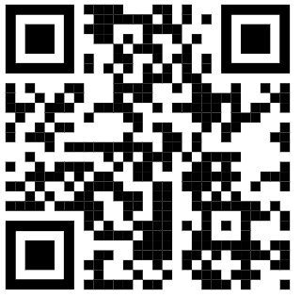
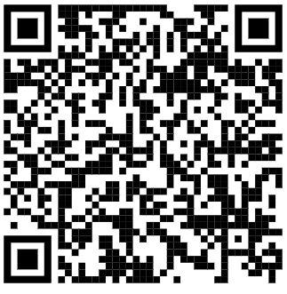
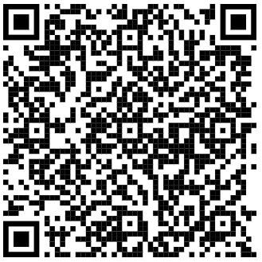
English Language
Subject Key Targets
…………………………………………………………………………………………………………
……………………………………………………
AQA
Exams
Paper 1 – Explorations in Creative Reading and Writing (Fiction) – 23rd May 2024 (am) – 1 hour
Paper 2 – Writers’ Viewpoints and Perspectives (Non-Fiction) – 6th June 2024 (am) – 45 minutes
Recommended revision materials
YouTube
CGP Workbook
Past Papers
Topics in each exam
Paper 1:
Q1 Comprehension
Q2 Language Analysis
Q3 Structural Analysis
Q4 Evaluative response
Q5 Descriptive/Narrative Writing
Paper 2:
Q1 Comprehension
Q2 Summarising and Inference
Q3 Language Analysis
Q4 Comparing Writers’ Viewpoints
Q5 Opinionated Writing (Article, Speech, Letter)
Tips for the subject
Practise. Practise. Practise.
Know the exam paper question types and practise your timing for each question.
Paper 1
Question 4 and 5 are worth a combined 60 marks – you must answer these.
What do you learn from the ‘Letterbox’?
Read the text – what is happening at a surface level? What is the writer hinting at in the subtext?
For Question 5, craft your writing – it is all about your quality, not quantity.
Paper 2
For Question 2, read the question carefully to be clear about the focus of your inferences.
For Question 4, you must compare the writers’ views/opinions – what do they think/feel and how do they show this?
For Question 5 use the 5 art plan: Introduction – 3 main ideas – conclusion.

Slide 8
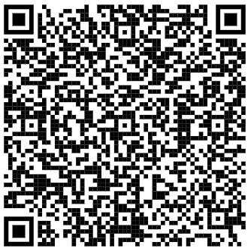
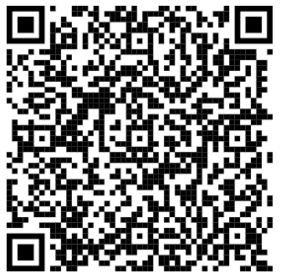
English Literature
Subject Key Targets
…………………………………………………………………………………………………………
……………………………………………………
AQA
Exams
Paper 1 – Shakespeare and 19th Century Novel – 13th May 2024 (am) – 1 hour 45 minutes
Paper 2 – Modern Texts and Poetry – 20th May 2024 (am) – 2 hours 15 minutes
Recommended revision materials
YouTube
CGP Guides and Workbooks
Past Papers
Topics in each exam
Paper 1:
Section A - Shakespeare – Macbeth (Character Presentation, Power, Ambition, Kingship, Violence, Supernatural, Role of Women, Heroism, Appearance vs Reality, Relationships in the play)
Section B - 19th Century Novel - A Christmas Carol (Character Presentation, Redemption, Christmas Spirit, Poverty, Victorian Attitudes, Role of the Ghosts, Relationships in the novel)
Paper 2:
Section A - Modern Texts – An Inspector Calls (Character Presentation, Class System, Gender Roles, Responsibility, Socialism vs Capitalism, Relationships in the play)
Section B – Anthology Poetry Comparison – Power and Conflict (All 15 poems from the AQA Power and Conflict anthology)
Section C – Unseen Poetry – Poetry Analysis based on 1 unseen poem; Comparing methods used by poets in 2 unseen poems.
Tips for the subject
For each text know the plot, characters, themes, key context information and the writer’s main intentions for the text.
Practise essay writing, including the use of thesis statements.
For the poetry comparison essay, compare 2 similarities and 1 difference in the poems.
Learn key quotations for each key characters/theme/poem – 3 each.
Learn key ideas/intentions for each write/poet.

Slide 9
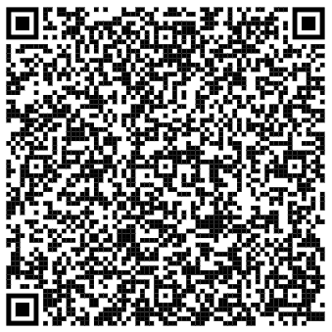
Mathematics
Subject Key Targets
…………………………………………………………………………………………………………
……………………………………………………
Edexcel
Exams
Paper 1 – Non-calculator – 16th May 2024 (am) – 1 hour 30 minutes
Paper 2 – Calculator – 3rd June 2024 (am) – 1 hour 30 minutes
Paper 3 – Calculator – 10th June 2024 (am) – 1 hour 30 minutes
Recommended revision materials
CGP Guides and Workbooks
Topics in each exam
Each exam has a possibility of including any area studied and some are repeated across more than one exam paper.
Tips for the subject
Answer ALL the questions.
This means answer as many as you can. Only by getting all of them right will you obtain full marks.
Many mathematics papers start with straightforward questions which may be shorter than those that follow. If this is the case work through them to build up your confidence. Do not overlook any part of a question and double check that you have seen everything on each paper, look especially at the back page in case there is a question there!
Make sure you understand key words. The following glossary may help you in answering questions:
Write down, state – no explanation is needed for an answer
Calculate, find, show, solve – include enough working to make your method clear
Write down the figures on your calculator and then make a suitable rounding. Don’t round the numbers during the calculation. This will often result in an incorrect answer.
Don’t forget to check your answers, especially to see that they are reasonable. The mean height of a group of men will not be 187 metres!

Slide 10
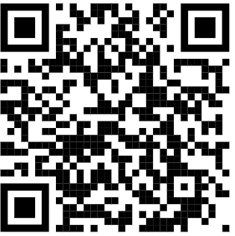
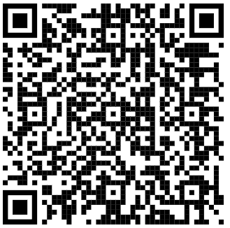
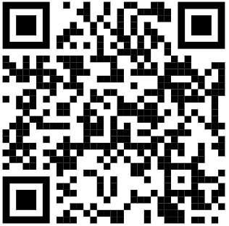
Combined Science
Subject Key Targets
…………………………………………………………………………………………………..
………………………………………………..
AQA
Exams
Biology Paper 1 – 10th May 2024 (am) – 1 hour 15 minutes
Chemistry Paper 1 – 17th May 2024 (am) – 1 hour 15 minutes
Physics Paper 1 – 22nd May 2024 (am) – 1 hour 15 minutes
Biology Paper 2 – 7th June 2024 (pm) – 1 hour 15 minutes
Chemistry Paper 2 – 11th June 2024 (am) – 1 hour 15 minutes
Physics Paper 2 – 14th June 2024 (pm) – 1 hour 15 minutes
Recommended revision materials
Primrose Kitten site
CGP Guides
YouTube
Topics in each exam
Biology Paper 1 – Cell biology, organisation, infection and response and bioenergetics.
Chemistry Paper 1 – Atomic structure and the periodic table, bonding, structure and the properties of matter, quantitative chemistry, chemical changes and energy changes.
Physics Paper 1 – Energy, electricity, particle model of matter and atomic structure.
Biology Paper 2 – Homeostasis and response, inheritance, variation and evolution and ecology.
Chemistry Paper 2 – Chemical changes, organic chemistry, chemical analysis, chemistry of the atmosphere and using resources.
Physics Paper 2 – Forces, waves, magnetism and electromagnetism.
Tips for the subject
Use the resources regularly and group together topics that will be in the same exam paper.

Slide 11
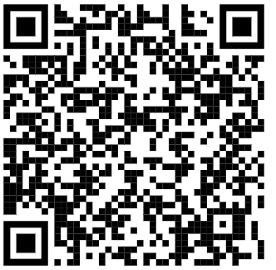
Biology
Subject Key Targets
…………………………………………………………………………………………………………
……………………………………………………
AQA
Exams
Biology Paper 1 – 10th May 2024 (am) – 1 hour 45 minutes
Biology Paper 2 – 7th June 2024 (pm) – 1 hour 45 minutes
Recommended revision materials
Primrose Kitten site
CGP Guides
YouTube
Topics in each exam
Biology Paper 1 – Cell biology, organisation, infection and response and bioenergetics.
Biology Paper 2 – Homeostasis and response, inheritance, variation and evolution and ecology.
Tips for the subject
Use the resources regularly and group together topics that will be in the same exam paper.

Slide 12
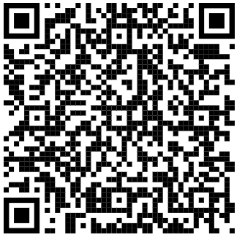
Chemistry
Subject Key Targets
…………………………………………………………………………………………………………
……………………………………………………
AQA
Exams
Chemistry Paper 1 – 17th May 2024 (am) – 1 hour 45 minutes
Chemistry Paper 2 – 11th June 2024 (am) – 1 hour 45 minutes
Recommended revision materials
Primrose Kitten site
CGP Guides
YouTube
Topics in each exam
Chemistry Paper 1 – Atomic structure and the periodic table, bonding, structure and the properties of matter, quantitative chemistry, chemical changes and energy changes.
Chemistry Paper 2 – Chemical changes, organic chemistry, chemical analysis, chemistry of the atmosphere and using resources.
Tips for the subject
Use the resources regularly and group together topics that will be in the same exam paper.

Slide 13
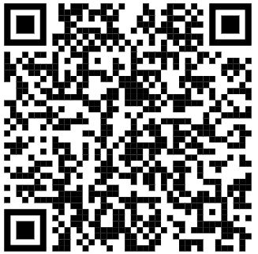
Physics
Subject Key Targets
…………………………………………………………………………………………………………
……………………………………………………
AQA
Exams
Physics Paper 1 – 22nd May 2024 (am) – 1 hour 45 minutes
Physics Paper 2 – 14th June 2024 (pm) – 1 hour 45 minutes
Recommended revision materials
Primrose Kitten site
CGP Guides
YouTube
Topics in each exam
Physics Paper 1 – Energy, electricity, particle model of matter and atomic structure.
Physics Paper 2 – Forces, waves, magnetism and electromagnetism.
Tips for the subject
Use the resources regularly and group together topics that will be in the same exam paper.

Slide 14
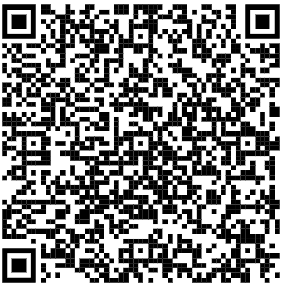
Geography
Subject Key Targets
…………………………………………………………………………………………………………
……………………………………………………
AQA
Exams
Paper 1 – Living with the Physical Environment – 17th May 2024 (pm) – 1 hour 30 minutes
Paper 2 – Challenges in the Human Environment – 5th June 2024 (am) – 1 hour 30 minutes
Paper 3 – Geographical Applications – 14th June 2024 (am) – 1 hour 30 minutes
Recommended revision materials
CGP Guides and Workbooks
Topics in each exam
Paper One Natural Hazards (Tectonics, Weather and Climate Change)
Living World (Ecosystems, Tropical Rainforests and Hot Deserts)
River Landscapes of the UK
Coastal Landscapes of the UK
Paper Two
Urban Issues and Challenges (Manchester and Rio De Janiero)
Changing Economic World (UK and Nigeria)
Resource Management (Focus on Energy)
Paper Three
Pre-release (Available April 2024)
Unseen Fieldwork
Own Fieldwork (New Islington and Weir at Burrs Country Park)
Tips for the subject
Paper 1 – Answer questions 1, 2, 3 and 4 – Do not answer question 5 (Glacial Landscapes)
Paper 2 – Answer questions 1, 2, 3 and 4 or 5 or 6
Paper 3 – Answer all questions.

Slide 15
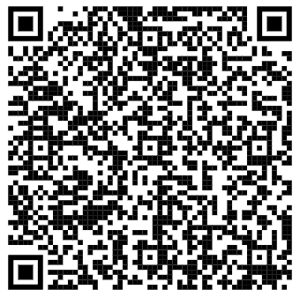
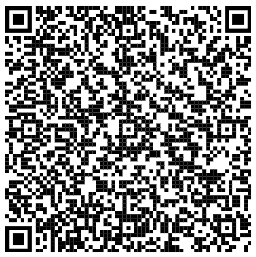
History
Subject Key Targets
…………………………………………………………………………………………………………
……………………………………………………
AQA
Exams
Paper 1 – 15th May 2024 (am) – 2 hours
Paper 2 – 4th June 2024 (am) – 2 hours
Recommended revision materials
CGP Guides and Workbooks
Heys Paper Two Revision Booklet
Topics in each exam
Paper 1 Section AD: America, 1920-1973: Opportunity and inequality
Section BB: Conflict and tension – The inter-war years, 1918-1939 1
Paper 2
Section AB: Britain: Power and the people: c1170 to the present day
Section BC: Elizabethan England, c1568-1603
Tips for the subject
Always answer the largest mark questions first.
Ensure you revise Drake’s Circumnavigation, as you will be getting a 16 mark question on this that is worth 10% of your final mark.

Slide 16
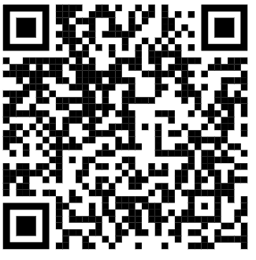
RE
Subject Key Targets
…………………………………………………………………………………………………………
……………………………………………………
Eduqas
Exams
Paper 1 – 9th May 2024 (am) – 2 hours
Paper 2 – 16th May 2024 (pm) – 1 hour
Paper 3 – 7th June 2024 (am) – 1 hour
Recommended revision materials
Workbook
Topics in each exam
Paper 1 - Religious, Philosophical and Ethical Studies in the Modern World
Paper 2 - Christian beliefs and practices
Paper 3 - Islam beliefs and practices
Tips for the subject
Ensure you have memorized brief key religious quotes to use as evidence to support arguments.

Slide 17
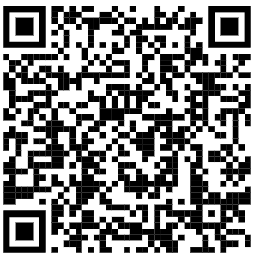
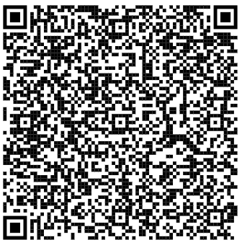
Travel and Tourism
Subject Key Targets
…………………………………………………………………………………………………………
……………………………………………………
Pearson
Exams
Paper 1 – Component 3: Influences in Global Travel and Tourism – 3rd May 2024 – 2 hours
Recommended revision materials
ZigZag Resources
Heys Revision Materials
Topics in each exam
Learning Outcome A: Factors Influencing Global Travel & Tourism
Learning Outcome B: Impact of Travel & Tourism Sustainability
Learning Outcome C: Destination Management
Tips for the subject
Revise Component 1 and Component 2 to add depth to Component 3.

Slide 18
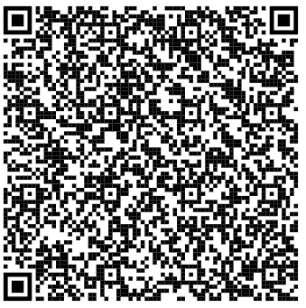
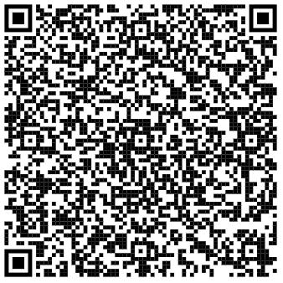
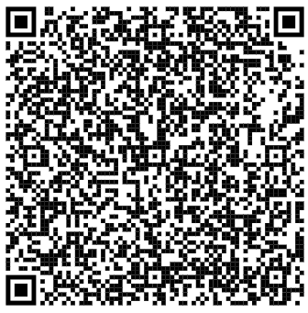
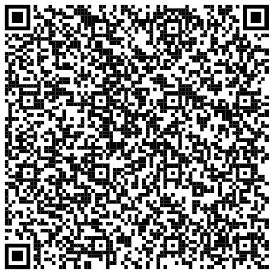
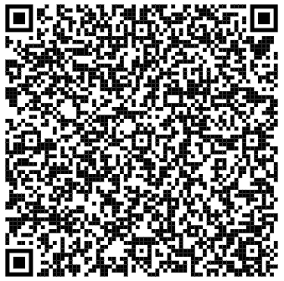
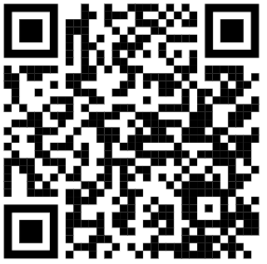
French
Subject Key Targets
…………………………………………………………………………………………………………
……………………………………………………
Edexcel
Exams
Paper 1 – Listening – 14th May 2024 (am) – 35 minutes F, 45 minutes H
Paper 2 – Reading – 14th May 2024 (am) – 45 minutes F, 1 hour H
Paper 3 – Writing – 24th May 2024 (am) – 1 hour 15 minutes F, 1 hour 20 minutes H
Speaking exams – April May 2024
Recommended revision materials
Aiming for Grade 9
Reading
Aiming for Grade 5
Reading
Aiming for Grade 9
Writing
Topics in each exam
Identity & culture
Local area, holiday & travel
School
Future aspirations, study and work
International and global dimension
Aiming for Grade 5
Writing
Pearson Revision Workbook
BBC Bitesize
Tips for the subject
Go through Reading & Listening tasks in the workbook & on Bitesize
Re-visit previously learned vocabulary regularly - self quizzes
Group revision to practice for the conversation

Slide 19
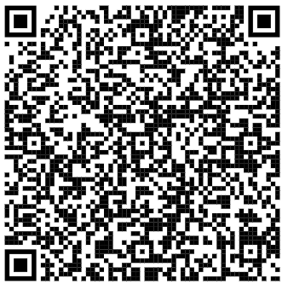
PE
Subject Key Targets
…………………………………………………………………………………………………………
……………………………………………………
OCR
Exams
Paper 1 – 22nd May 2024 (pm) – 1 hour
Paper 2 – 34d June 2024 (pm) – 1 hour
Recommended revision materials
CGP Workbook
Topics in each exam
Paper 1- Anatomy and Physiology, Physical Training
Paper 2- Socio-Cultural Influences, Sports Psychology, Health Fitness and Wellbeing
‘Using data’ is covered across both papers
Tips for the subject
Keep on top of Controlled Assessment via Teams
Use Practical Lessons to Prepare for Moderation (3 sports performances)
Read questions carefully.
Short answer questions are usually worth between 1 and 4 marks. To get the marks, you will often need to show your PE Practical knowledge and ability to apply it to a situation.
Extended writing questions are worth 6 marks. They will require your ability to analyse, or to weigh up the advantages and disadvantages of something. At the end of these answers, write a conclusion where you make a judgement. In these answers, think carefully about:
Structuring your answer
Making points in a logical way
Answering the question without going off from the point
Using Spelling, Punctuation and Grammar, as well as PE vocabulary

Slide 20
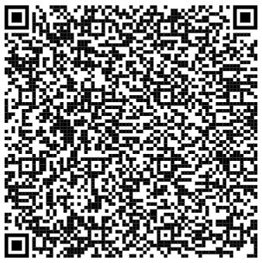
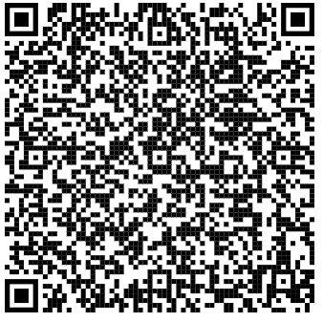
Sports Studies
Subject Key Targets
…………………………………………………………………………………………………………
……………………………………………………
OCR
Exams
Paper 1 – 13th May 2024 (pm) – 1 hour 15 minutes
Recommended revision materials
CGP Revision Guide
CGP Workbook
Topics in each exam
Issues Affecting Participation
Promoting Values
Hosting a Major Sporting Event
National Governing Bodies
Technology in Sport
Tips for the subject
Keep on top of Controlled Assessment - Practical Performance Tasks 1 and 2 should be complete by now. Task 3 should be planned and ready to deliver.
Practice all 3 types of questions:
Multiple Choice- Tick the right box. If you make a mistake, put a cross over the wrong answer and tick the box of your new answer.
Short Answer Questions- 1-4 marks. Read questions carefully. These are an opportunity to show your knowledge and apply it to a situation- by evaluating or analysing something. Pay particular attention to the number of points it asks for; for example “state two reasons.”
Extended writing questions- 6-8 Marks. Discuss means you need to write about the advantages or disadvantages of something, and come to a conclusion. There are often bullet points within the question- be sure you refer to them to help you to answer the full questions.

Slide 21
Textiles
Subject Key Targets
…………………………………………………………………………………………………………
……………………………………………………
AQA
Exams
Component 1 portfolio to be completed by the end of January 2024.
Exam paper given out at the start of January for pupils to work on preparation work. 10 hours of unaided work (dependent on content of the unreleased exam and what materials pupils choose to use).
Recommended revision materials
Pupils will be required to conduct their own research and development on their chosen brief, appropriate for their theme.
Topics in each exam
Exam paper was released this week and will be discussed in lesson time.
Tips for the subject
Pupils should decide on which brief to follow as soon as possible and conduct a range of research to inspire their work, all of which must be documented. Pupils must explore the theme thoroughly and annotate their work as it progresses, outlining their thought process. They must show how they have developed their own “personal response” through developing design ideas inspired by the research and experimenting conducted.

Slide 22
Art and Design
Subject Key Targets
…………………………………………………………………………………………………………
……………………………………………………
AQA
Exams
Exam paper given out at the start of January for pupils to work on preparation work. 10 hours of unaided work provisionally on the 22 and 23rd April (dependent on content of the unreleased exam and what media sources pupils choose to use).
Recommended revision materials
Pupils will be required to conduct their own research and development on their chosen brief, using a range of Art and Design media, appropriate for their theme.
Topics in each exam
Exam paper was released this week and will be discussed in lesson time.
Tips for the subject
Pupils should decide on which brief to follow as soon as possible and conduct a range of research to inspire their work, all of which must be documented. Research should include study pages on relevant artists, pupils’ own photos and own studies in a variety of media. Pupils must explore the theme thoroughly and annotate their work as it progresses, outlining their thought process. They must show how they have developed their own “personal response” through developing design ideas inspired by the research and experimenting conducted.

Slide 23
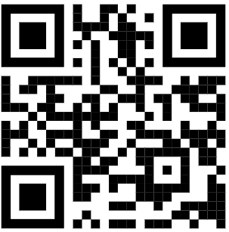
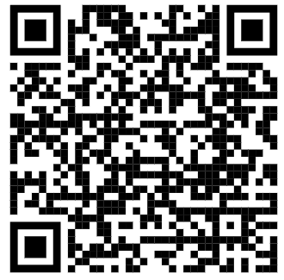
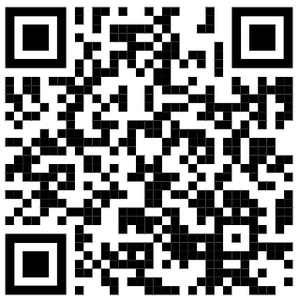
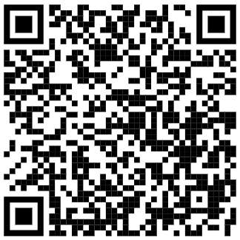
Drama
Subject Key Targets
…………………………………………………………………………………………………………
……………………………………………………
Eduqas
Exams
Component 1 – Devised Performance – completed 15th December 2023
Component 2 – Scripted Performance – 22nd March 2024
Component 3 – Interpreting Theatre – 9th May 2024 (pm) – 1 hour 30 minutes
Recommended revision materials
Padlet
Eduqas
BBC Bitesize
Noughts and Crosses resource
Topics in each exam
Set Text: Noughts and Crosses (Malorie Blackman)
Live Theatre Review: Human Nurture
Tips for the subject
Ensure you know the set text inside out.
Ensure you watch the recording for Human Nurture as much as possible.

Slide 24
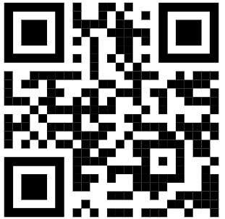
Media
Subject Key Targets
…………………………………………………………………………………………………………
……………………………………………………
Pearson
Exams
Brief released for Component 3 - 15th January 2024.
Exam work will be completed throughout a 12 week supervised window during timetabled lesson. There will be an independent research period based on the brief.
Task 1 – Part A – Ideas Log, Part B – Planning Material 5 hours
Task 2 – Creating Media Product and Review - 5 hours
Deadline 10th May.
Recommended revision materials
Padlet
Topics in each exam
Students choose to create a product from the Print Media or Moving Image Sector.
Tips for the subject
Ensure you research the brief thoroughly.
Ensure you understand the typical conventions for your chosen sector.

Slide 25
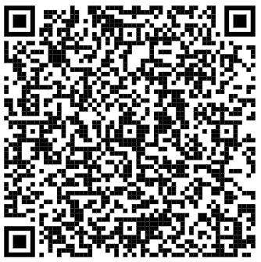
Music
Subject Key Targets
…………………………………………………………………………………………………………
……………………………………………………
Pearson
Exams
Brief released for Component 3 - 15th January 2024.
Exam work will be completed throughout a 12 week supervised window during timetabled lesson. There will be an independent research period based on the brief.
Deadline 10th May.
Recommended revision materials
Sample assessments
Topics in each exam
Preparatory period.
Initial response to the music brief.
Create a music product.
Individual commentary on the creative process.
Tips for the subject
Ensure you link to the brief throughout.
Ensure you consider the creative process throughout and keep notes as you go along as these can be taken into activities.

Slide 26
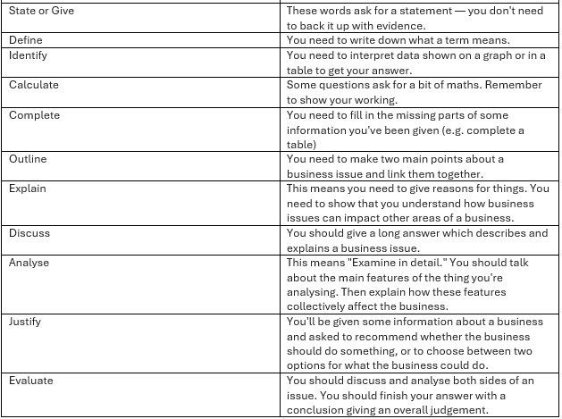
Business Studies
Subject Key Targets
…………………………………………………………………………………………………………
……………………………………………………
Edexcel
Exams
Paper 1 – Investigating Small Business – 14th May 2024 (pm) – 1 hour 45 minutes
Paper 2 – Building A Business – 5th June 2024 (pm) – 1 hour 45 minutes
Recommended revision materials
CGP Guide which has been provided to all students.
Topics in each exam
Paper 1:
Enterprise and entrepreneurship, spotting a business opportunity, putting a business idea into practice, making the business effective and understanding external influences on business.
Paper 2:
Growing the business, making marketing decisions, making product decisions, making financial decisions and making human resource decisions.
Tips for the subject

Slide 27
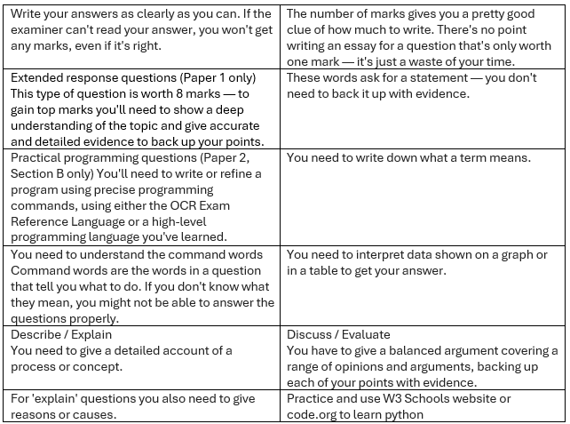
Computer Science
Subject Key Targets
………………………………………………………………………………………………
………………………………………………
OCR
Exams
Paper 1 – Computer Systems – 15th May 2024 (pm) – 1 hour 30 minutes
Paper 2 – Computational Thinking, Algorithms and Programming – 21st May 2024 (pm) – 1 hour 30 minutes
Recommended revision materials
CGP Guide which has been provided to all students.
Topics in each exam
Paper 1:
Components of a computer system, data representation, networks and issues.
Paper 2:
Algorithms, programming and design, testing and IDEs.
Tips for the subject

Slide 28
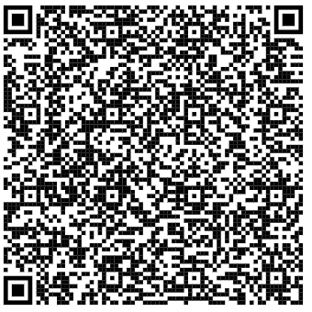
Hospitality and Catering
Subject Key Targets
…………………………………………………………………………………………………………
……………………………………………………
WJEC
Exams
Paper 1 – The Hospitality and Catering Industry – 20th June 2024 (pm) – 1 hour 20 minutes
Recommended revision materials
Revision Guide
Topics in each exam
Hospitality and catering provision, how hospitality and catering providers operate, health and safety in hospitality and catering and food safety in hospitality and catering.
Tips for the subject
Take your time, and make sure you read the instructions and questions carefully. Re-read each question so that you understand exactly what you must do, underlining or highlighting key information in the question that you need to answer.

Slide 29
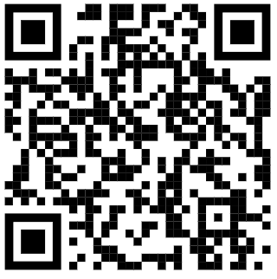
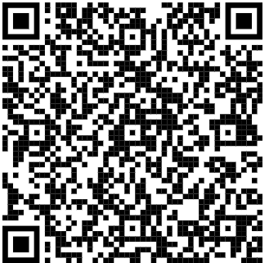
Food Preparation and Nutrition
Subject Key Targets
…………………………………………………………………………………………………………
……………………………………………………
AQA
Exams
Paper 1 – Food Preparation and Nutrition – 19th June 2024 (am) – 1 hour 45 minutes
Recommended revision materials
CGP Guide
CGP Workbook
Topics in each exam
Section 1:
Multiple choice (20 questions)
Section 2:
Food nutrition and health, food science, food safety, food choice and food provenance.
Tips for the subject
Answer ALL questions.

Slide 30
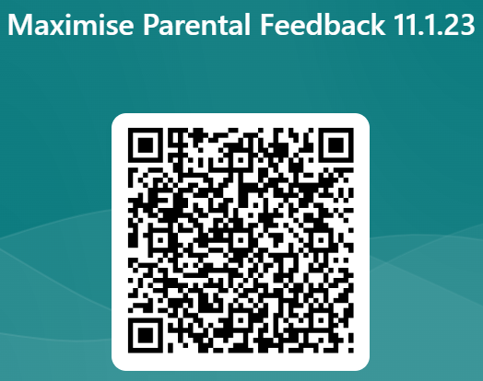
Takeaways
What can you do this week?
What can you do this month?
3. What do you need to help you?
4. How will you access this support?
“Maximise our potential, to be the best we can be, every day.”

