Slide 1
Maximise
11th January 2024
Online Presentation
Parental engagement has a positive impact on average of 4 months’ additional progress per year. (EFF 2018)
Parental engagement approaches have been evaluated in 10 countries around the world with broadly similar findings.
Objective today is to provide practical strategies with tips, support, and resources to assist learning and revision at home.
“Maximise our potential, to be the best we can be, every day

Slide 2
Maximise - Booklet
Booklet – outlining all your subjects and tips
“Maximise our potential, to be the best we can be, every day

Slide 3
Maximise – Resilience
13 Top Tips to make your revision effective
1. Start revising early
2. Timed focused revision
3. Continuation - plan your revision using a timetable
4. Stick to the plan
5. Don't spend ages making your notes look pretty
6. Location (set up a nice, tidy study space)
7. Vary your revision with different activities
8. Stick the challenging revision notes all around your house
9. Practice papers and questions – Get expert help!
10. Overview (Set aside time to do fun things)
11. Keep your phone and other distractions away.
12. Don't just read your notes
13. Take your revision wherever you go
“Maximise our potential, to be the best we can be, every day

Slide 4
Maximise – Resilience
Perfect Location to revise
Dedicated area Sunlight
No distractions
Light
Notes
Space
Portable location
Box
Pens
Pencils
Rulers
Highlighters
Folders of Subjects
- Revision Guides
- Past Papers
“Maximise our potential, to be the best we can be, every day

Slide 5
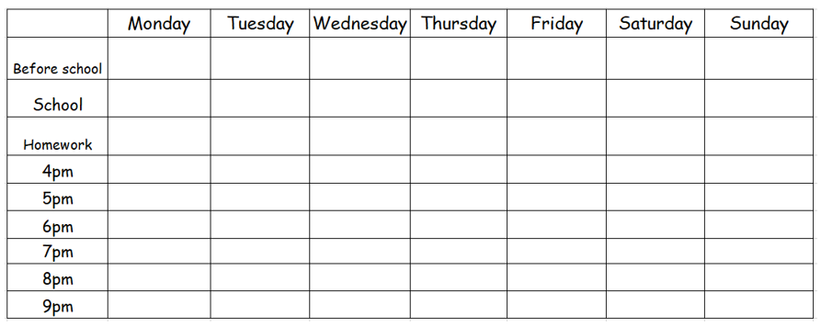
Maximise – Resilience
Model layout of how to organise your revision timetable
“Maximise our potential, to be the best we can be, every day

Slide 6
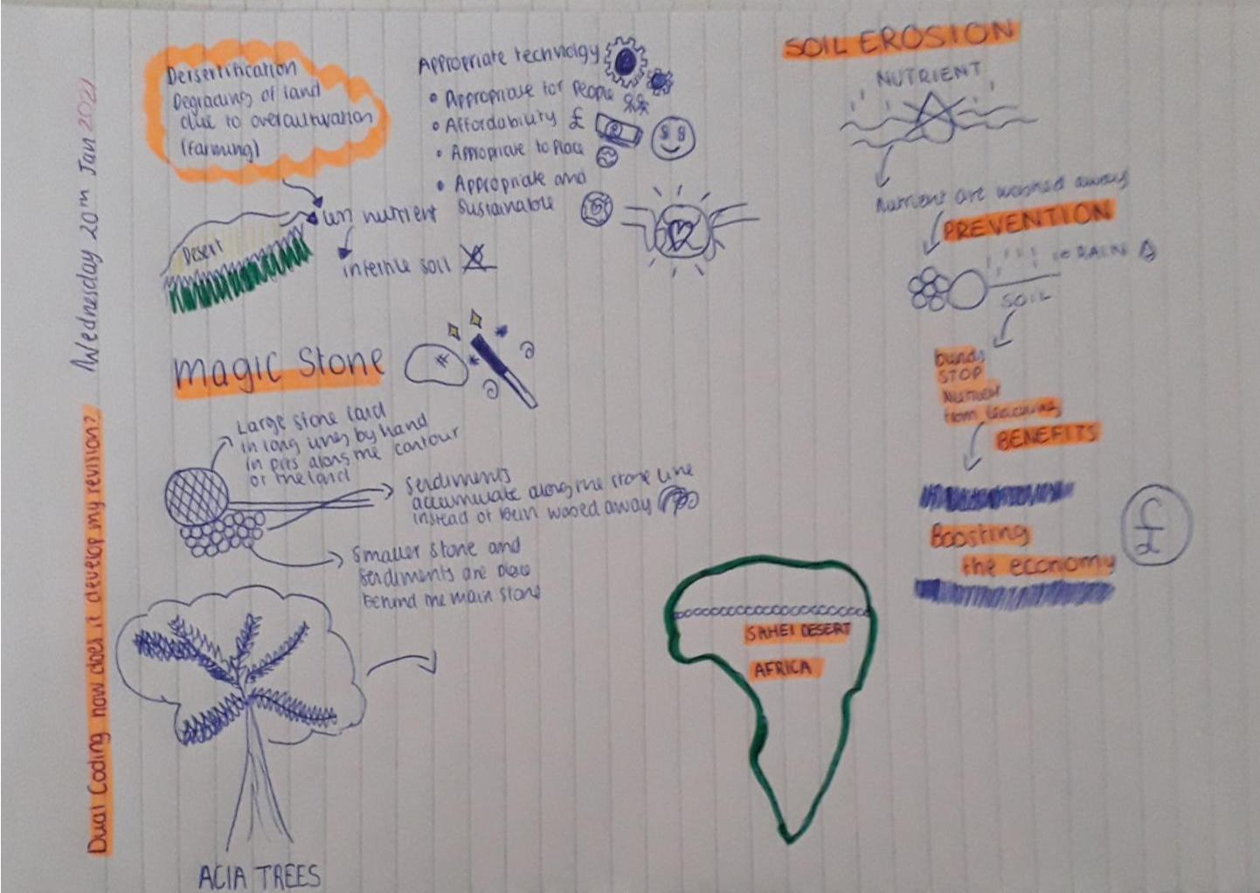
Maximise – Revision Techniques
Working Memory
Dual Coding
Ebbinghauss : The forgetting curve
You remember most straight away
Review/Revise each piece / theme / idea / technique 4 times
To transfer information from the Short term into the Long term memory
Dual coding is adding images/diagrams to aid memory retention
5. Don't spend ages making your notes look pretty
“Maximise our potential, to be the best we can be, every day

Slide 7
Maximise – Revision Techniques
Flash Cards
How to use them
1 – Write down key information from specific case studies – ask family to test you (Verbally)
2 – Create flash cards – Theme on one side
Recall all information verbally / information missed rewrite this in notes
Repeat
3 – Key quotes / formula / information and read over for short intense revision
4 – Purchase external providers using their questions to guide your learning
Flash Cards: a card containing a small amount of information, held up for pupils to see, as an aid to learning
“Maximise our potential, to be the best we can be, every day

Slide 8
Maximise – Revision Techniques
Past Papers
Past papers are previous exams that have been released by the exam boards. They have released 2022 with Markschemes and all years previous
Examiner’s reports
If you want to take your revision a step further, then it’s also a good idea to read the examiners’ reports for past exams. These are available online. You just have to search for the examiner’s report for the exam board, the subject and the year.
Advantages of using Past Papers
1. Familiarity with the structure of a paper and the language they use.
2. Work on your time management
3. Understand the allocation of marks and marking scheme
4. Good way to practice writing
5. Analyse
“Maximise our potential, to be the best we can be, every day

Slide 9
Maximise – Support
What you will experience:
Increased anxiety
Increased stress
Normal – Regulate your emotions
Control the controllables
Be organised
Follow the practical advice given.
Feelings/Emotions
“Maximise our potential, to be the best we can be, every day

Slide 10
Maximise – Support
Timescale
17 – Actual Weeks left until 13th May
15 – In school Weeks until 13/5
45 – Maximum Options lessons left
“Maximise our potential, to be the best we can be, every day

Slide 11
Maximise – Support
90% attendance means your child misses 10%
This is equivalent to missing ½ a day every week.
That’s three lessons worth of learning that your child is missing out on, every week.
That’s a total of 19 days of absence over the academic year
Attendance and Punctuality
73% of pupils who have over 95% attendance achieve five or more GCSEs at grades 9 to 4.
Get in front of the experts
Teachers can only effectively teach your child if they are present, on time and ready to learn
Department for Education research shows that 17 school days of absence results in all of a student’s GCSE grades dropping by one grade.
“Maximise our potential, to be the best we can be, every day

Slide 12
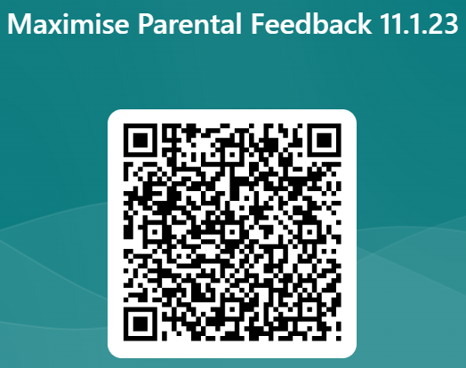
Maximise – Support
Takeaways
What can you do this week?
What can you do this month?
What do you need to help you?
How will you access this support?
“Maximise our potential, to be the best we can be, every day

