Slide 1
ANTI-BULLYING
WEEK 2022

Slide 2
Anti-Bullying Week 2022: Reach Out
“
Bullying affects millions of lives and can leave us feeling hopeless. But if we challenge it, we can change it. And it starts by reaching out.
It doesn’t stop with young people. From teachers to parents and influencers to politicians, we all have a part to play. Reach out to someone you trust if you need to talk. Reach out to someone if you know they’re being bullied. Reach out by being the change you want to see.
It takes courage, but it can change lives.
So, this Anti-Bullying Week, let’s come together and reach out to stop bullying.
“
Anti-Bullying Week 2022 – Reach out
2

Slide 3
https://www.youtube.com/watch?v=kjhp-67cKJA
Anti-Bullying Week 2022 – Reach out
3

Slide 4
What is bullying?
‘The repetitive, intentional hurting of one person or group by another person or group, where the relationship involves an imbalance of power. Bullying can be physical, verbal or psychological.
It can happen face to face or online.’
Anti-Bullying Week 2022 – Reach out
4

Slide 5
Types of bullying
PHYSICAL
VERBAL
Includes hitting, kicking, tripping, pushing or purposefully damaging other people’s property.
Includes name-calling, threatening, teasing, saying nasty or rude things to someone.
psychological
ONLINE
Includes spreading lies about someone, playing nasty jokes or excluding people.
Includes hurtful comments / messages / posts, excluding on purpose, spreading nasty gossip and imitating others online.
Anti-Bullying Week 2022 – Reach out
5

Slide 6
Take a moment to consider …
Two times you have reached out to someone in need
1
Two times someone has reached out to you when you needed help
2
Anti-Bullying Week 2022 – Reach out
6

Slide 7
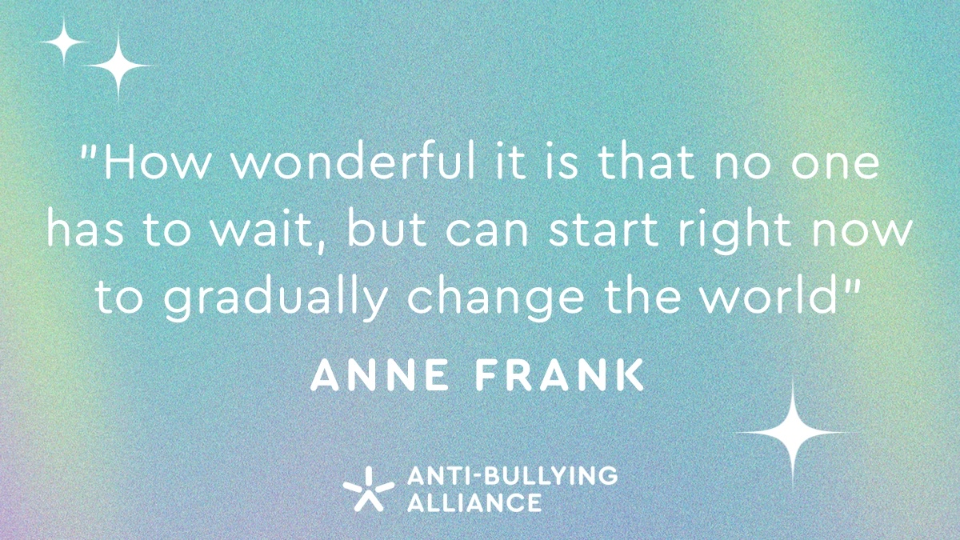
Anti-Bullying Week 2022 – Reach out
7

Slide 8
Who can we reach out to in our school?
1
Staff Name here
2
Staff Name here
3
Staff Name here
Anti-Bullying Week 2022 – Reach out
8

Slide 9
Reaching out to people when you need help is a great idea.
But imagine if we all considered each other’s feelings so well that no one needed to.
Are you aware how your behaviour, and language affects others?
Showing our school values of kindness and respect towards everyone in school would go a long way towards making The Heys School feel a happier and safer place for everyone.
We can always do so much more…

Slide 10
“
One of our core values is kindness. Is our school a kind school?
“

Slide 11
Kind acts that I have seen in the last week
Students saying thank you when I have done something to help them.
Students handing in lost property.
Students asking how my day was.
Students carrying something for a teacher.
Students volunteering for community projects (litter picking or food bank)
Students offering to put books away after lesson.
Students helping someone on crutches by carrying their bag for them.
Students picking up litter that wasn’t theirs.
Students stepping in to prevent a bullying incident.
Students holding a door for a teacher.
Students looking after someone who was upset.
Students offering to give books out at the start of lesson.
Students helping each other.
Students lending a piece of equipment to someone who doesn’t have it.
Students helping someone who is learning English.
Students looking after someone who is new to school.
Students reporting when they are worried about a friend.
Staff helping a student who was upset.
Students helping someone who speaks their home language.
Students sharing.
Students giving up their own time to help someone.
They might not seem like much but these small acts of kindness can make such a different to your day.
11

Slide 12
Students swearing at other students.
Not so kind acts that I have seen in the last week
Students pushing in the queues at lunchtime.
Students taking things that aren’t theirs.
Students swearing at staff.
Students behaving rudely in local shops.
Students throwing litter.
Students using discriminatory language towards others.
Students leaving a mess behind them in the canteen / Paragon.
Students making personal & hurtful comments about other students and staff.
Students graffitiing on walls.
Students sending nasty messages on social media.
Students bullying / isolating others.
Students “deadnaming” a student who has chosen to be known by a different name.
Students throwing paint over the driveway and walls of a house near school.
Students barging onto the bus with no regard others.
Students not clearing up their own rubbish.
Students causing damage to the toilets.
Students throwing food.
Students deliberately antagonising someone who is autistic just to get a reaction.
They might not seem like much to you but when someone is unkind, it can have a really negative impact on how they are feeling, especially as you don’t know what the rest of someone’s day has been like.
12

Slide 13
“
Is our school a kind school?
What do you think?
Have you done any of the things on the previous slide?
What is your contribution towards making our school a kind place?
“
13

Slide 14
If everyone acts with kindness, we could make a real difference together:
Think before you speak.
Be considerate and respectful to people.
Talk to each nicely. Ask rather than demand.
Don’t swear.
Show members of the local community how amazing our school can be by showing our values.

Slide 15
Thank you for being a part of
ANTI-BULLYING
WEEK 2022

